Slide 1
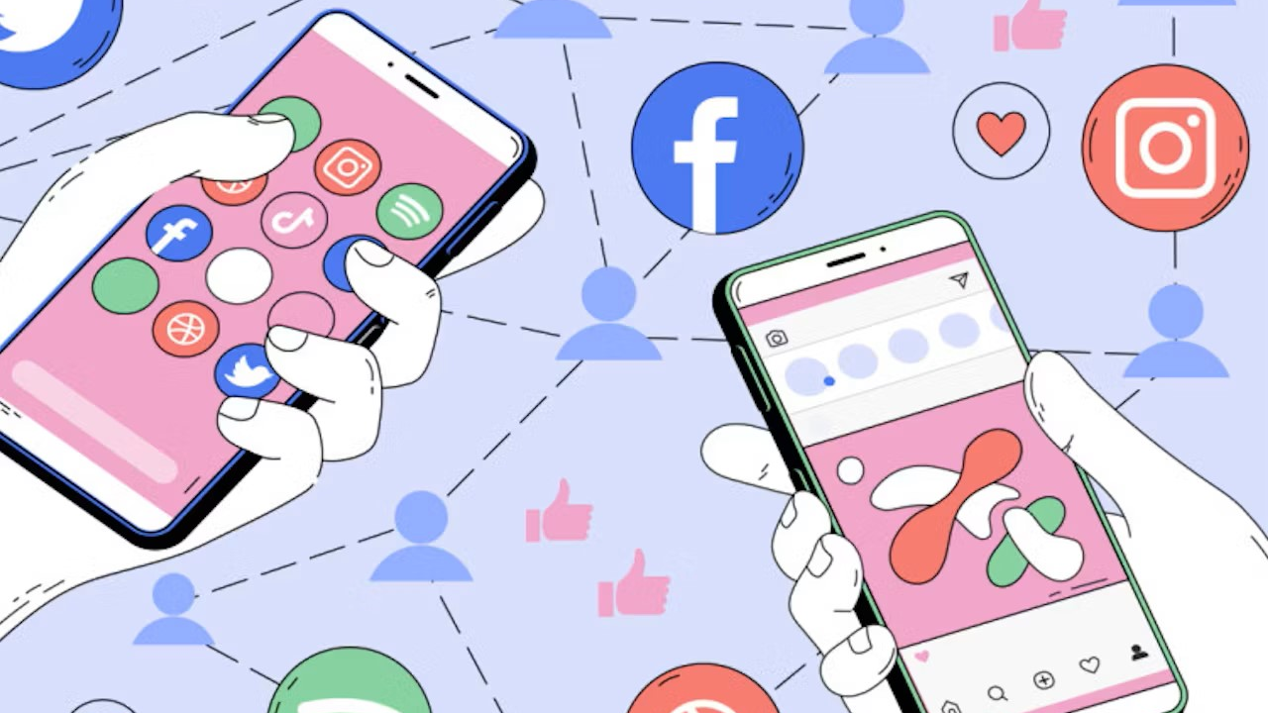
SOCIAL MEDIA and its Influence

Slide 2
What is ‘SOCIAL MEDIA’?
Social media is a collective term for websites and applications that focus on communication, community-based input, interaction, content-sharing, and collaboration.
People use social media to stay in touch and interact with friends, family, and various communities. Businesses use social applications to market and promote their products and track customer concerns.

Slide 3
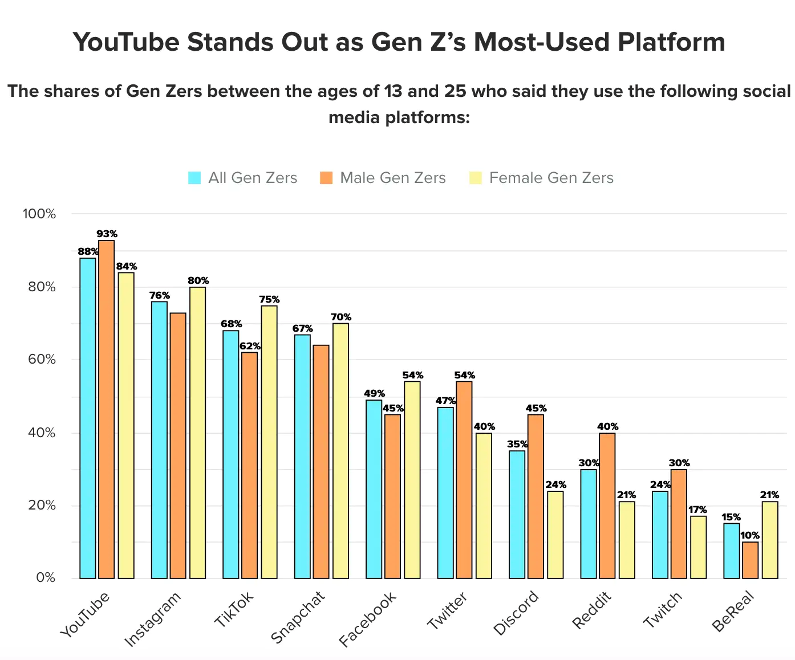
The most used social media apps in the gen z world.

Slide 4

YouTube
YouTube is an American online video sharing and social media platform headquartered in San Bruno, California, United States. Accessible worldwide, it was launched on February 14, 2005, by Steve Chen, Chad Hurley, and Jawed Karim. It is owned by Google and is the second most visited website, after Google Search.

Slide 5

Instagram
Instagram is a photo and video sharing social networking service owned by American company Meta Platforms, established October 6, 2010. The app allows users to upload media that can be edited with filters and organized by hashtags and geographical tagging. Posts can be shared publicly or with preapproved followers.

Slide 6
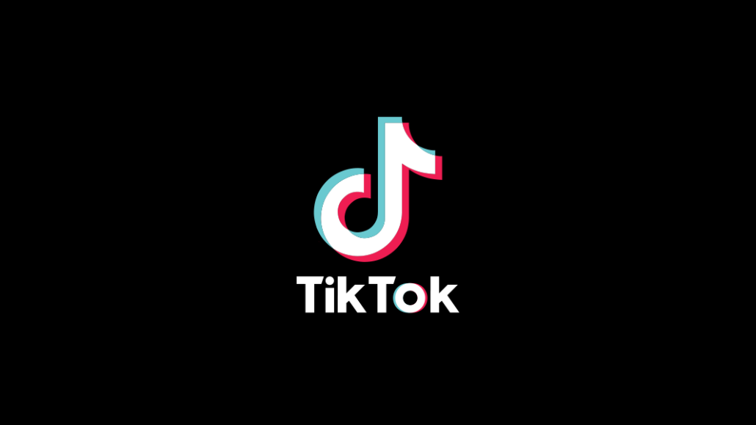
TikTok
TikTok, and its Chinese counterpart Douyin, is a short-form video hosting service owned by ByteDance. It was established September 2016. It hosts user-submitted videos, which can range in duration from 3 seconds to 10 minutes. Since their launches, TikTok and Douyin have gained global popularity

Slide 7
What influence does social media have on the new generation?
Like any form of technology, social media has both an upside and a downside. And when it comes to the social media effects on teens, there are significant pros and cons to take into account.
On the plus side, platforms like TikTok, Twitter, Instagram, and Snapchat can be lifesavers for teens who feel isolated or marginalized, particularly LGBTQ teens. In addition, social media helped teens feel more connected and not as lonely during the pandemic.
But the impact of social media on youth can also be significantly detrimental to mental health. In particular, social media and teen depression are closely linked. Furthermore, overuse of the apps exposes teens to cyberbullying, body image issues, and tech addiction, and results in less time spent doing healthy, real-world activities. And while the majority of parents believe they know what their child is posting on social media, according to a Pew Research poll, a survey of teens found that 70 percent of them are hiding their online behavior from their parents.

